Slide 1

Smart home automation
For saving electricity

Slide 2
Group Detail
Yug Patel AU1741017
Aditya Bajaj AU1741028
Shvansh Nautiyal AU1741037
Nisarg Gandhi AU1741099

Slide 3
Problem Definition
In India most of the people forgets to switch off fans and lights when they leave the room which cause a big loss of energy.Currently India faces a huge Problem of Electricity Shortage and there are many Villages in India which still doesn’t have electricity. So, saving Electricity is a huge task and very important for a developing Country like India.The IOT can offer the solution to this problem for saving electricity through Smart Home Automation System. The Home can be modernized by using recent technology which can be continuously monitored, so that fans and lights are not unnecessary kept on if there is no use of them.

Slide 4
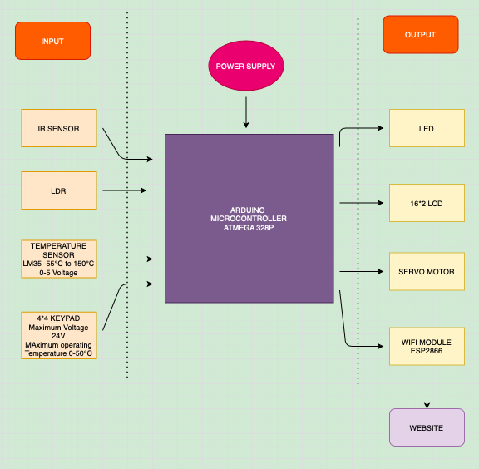
Block Diagram

Slide 5
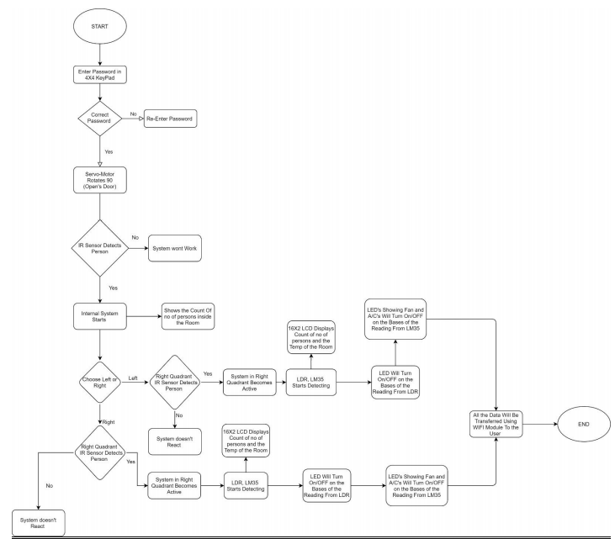
Flow Chart:

Slide 6
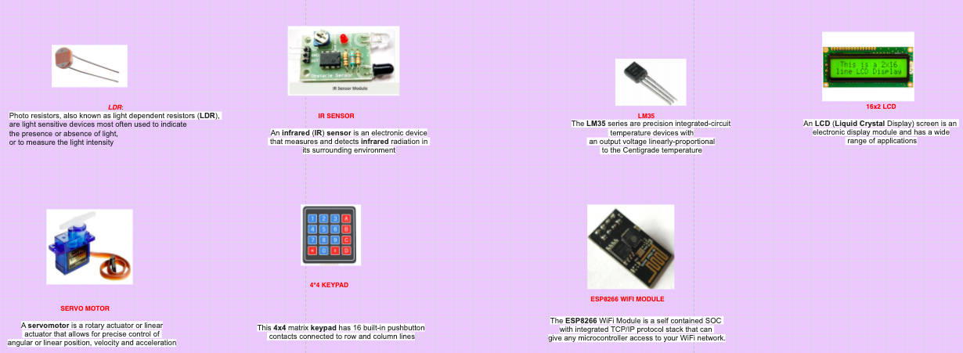
PBL Components:

Slide 7
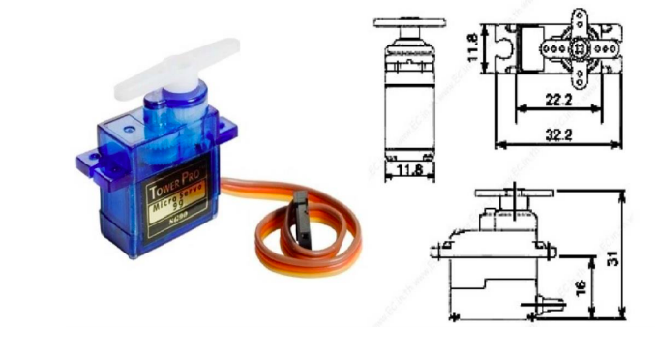
PBL COMPONENTS
SERVO MOTOR
Working: Servo motor works on the PWM ( Pulse Width Modulation ) principle, which means its angle of rotation is controlled by the duration of pulse applied to its control PIN. Basically servo motor is made up of DC motor which is controlled by a variable resistor (potentiometer) and some gears.The servo motor is specialized for high-response, high-precision positioning. As a motor capable of accurate rotation angle and speed control, it can be used for a variety of equipment.

Slide 8
PBL COMPONENTS
Applications
Security: When a person enters a correct password in the keypad, the servo motor will act as a door and will rotate 90 deg and will depict opening of the door. For our home automation project, we will be using the servo motor to control the door open and close

Slide 9
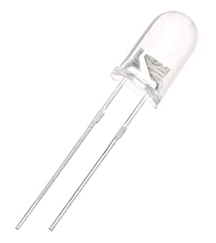
PBL COMPONENTS
IR SENSOR
Working: IR sensor is an electronic device, that emits the light in order to sense some object of the surroundings. An IR sensor can measure the heat of an object as well as detects the motion. Infrared lasers and Infrared LED's of specific wavelength used as infrared sources.Infrared sensors experience no wear and tear, and consequently have longer operating lives. IR sensors can provide more detail.

Slide 10
Hardware/ Software Problems:
1 Unavailability of Hardware:
Due the Current Scenario of Covid-19 we Didn’t have access to hardware Components like ESP8266 WIFI Module etc.

Slide 11
Hardware/ Software Problems:
2 Unavailability of Proper Simulator.
We were not able to find a proper simulator which have all the components which we needed and TinkerCad didn’t have all the Necessary Components.

Slide 12
Hardware/ Software Problems:
Software Problems:
Implementation and working of IR Sensor was pretty Challenging on Simulator like TinkerCad.
Using IR Remote To transmit Signal to Specific IR was also a problem
Due to unavailability of resources though which we can import value sense by our Servo Motor and Ir sensor to our webpage that we created.
For simulation we used Tinkercad and in that we faced problem for wifi module(ESP8266) as they have removed that module from tinkercad.

Slide 13
Real Life Implementation:
The sensor will be mounted with a different power supply than the appliances.
We will use transformers for the sensors in our circuit as the sensors will not be able to handle the excessive voltage of the main household system.
The IR sensors will be mounted on the entry points of the room. Also along with the entry and exit points, IR will also be mounted inside rooms to detect the presence and keep the count of number of people present inside the room or hallway.
We will use copper wiring which will minimise effects of water seepage in the house. Most of the sensors are mounted inside rooms which already prevents them from weather and unexpected damages.

Slide 14
Scenarios:
The main issue that we would face is that most of the sensors operate at very low temperatures than the actual main household voltage. This will lead us to modify our circuit.
The number of sensors would strictly depend upon the size of the room. If we typically use 2 IR sensors for an average sized room then there may be a possibility that the sensor is unable to detect the person due to the limited range of it.
The follow up problem would come up if we use more sensors than there are actually needed. The reading will differ in this case and it may give inaccurate results.
Data Security, Increase in cost, integration of IOT Products with IOT platforms.

Slide 15
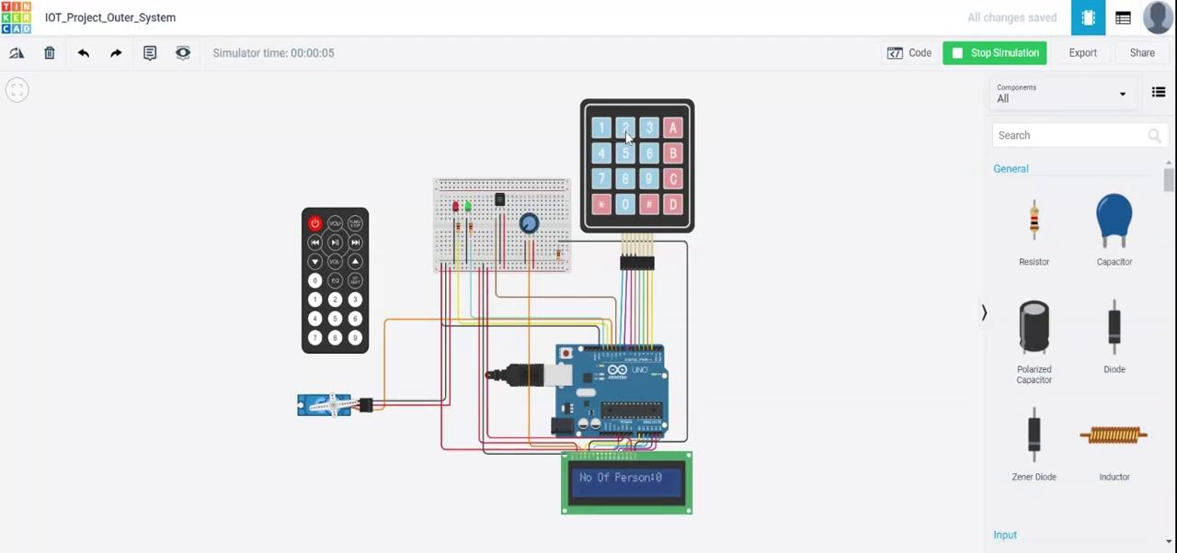
Project Demonstration:
Outer System:

Slide 16
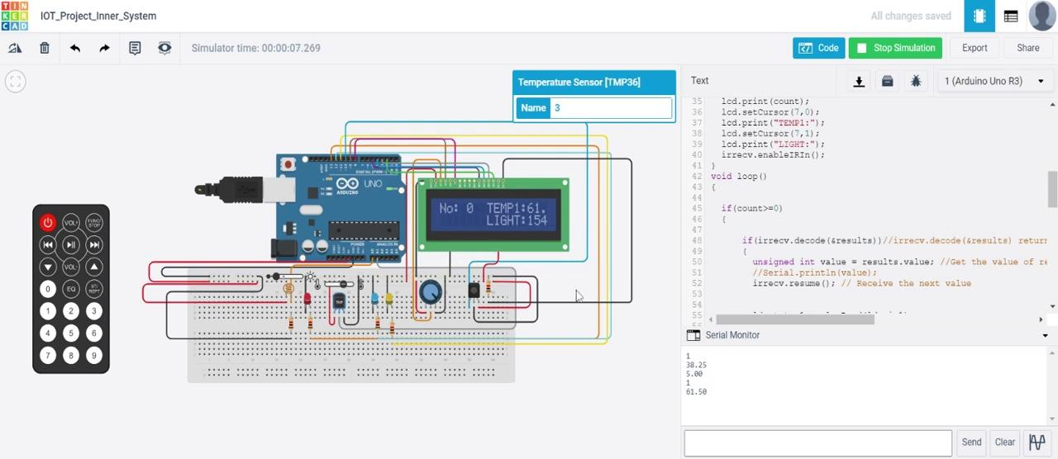
Project Demonstration:
Inner System:

Slide 17
Reference:
M. Asadullah and A. Raza, "An overview of home automation systems," 2016 2nd International Conference on Robotics and Artificial Intelligence (ICRAI), Rawalpindi, 2016, pp. 27-31, doi: 10.1109/ICRAI.2016.7791223.
Suseelan, Angel & Palaniappan, Satish & Hariharan, Naveen & Kesh, Naren & S, Vidhyalakshimi. (2015). Home Automation Systems - A Study. International Journal of Computer Applications. 116. 11-18. 10.5120/20379-2601.
Modrzyk, Nicolas. (2020). Vision and Home Automation. 10.1007/978-1-4842-5722-7_5
.
Sourav, Prasad & Prakash, Mishra & Kumar, Mishra. (2020). IoT in Home Automation. 10.1007/978-981-13-8676-3_4.
Salem, Abdulrahman & Alsharif, Ahmad & Alhejaili, Abdulaziz & Alam, Tanweer. (2020). Home Automation Systems. 10.13140/RG.2.2.31684.58245.

